Slide 1
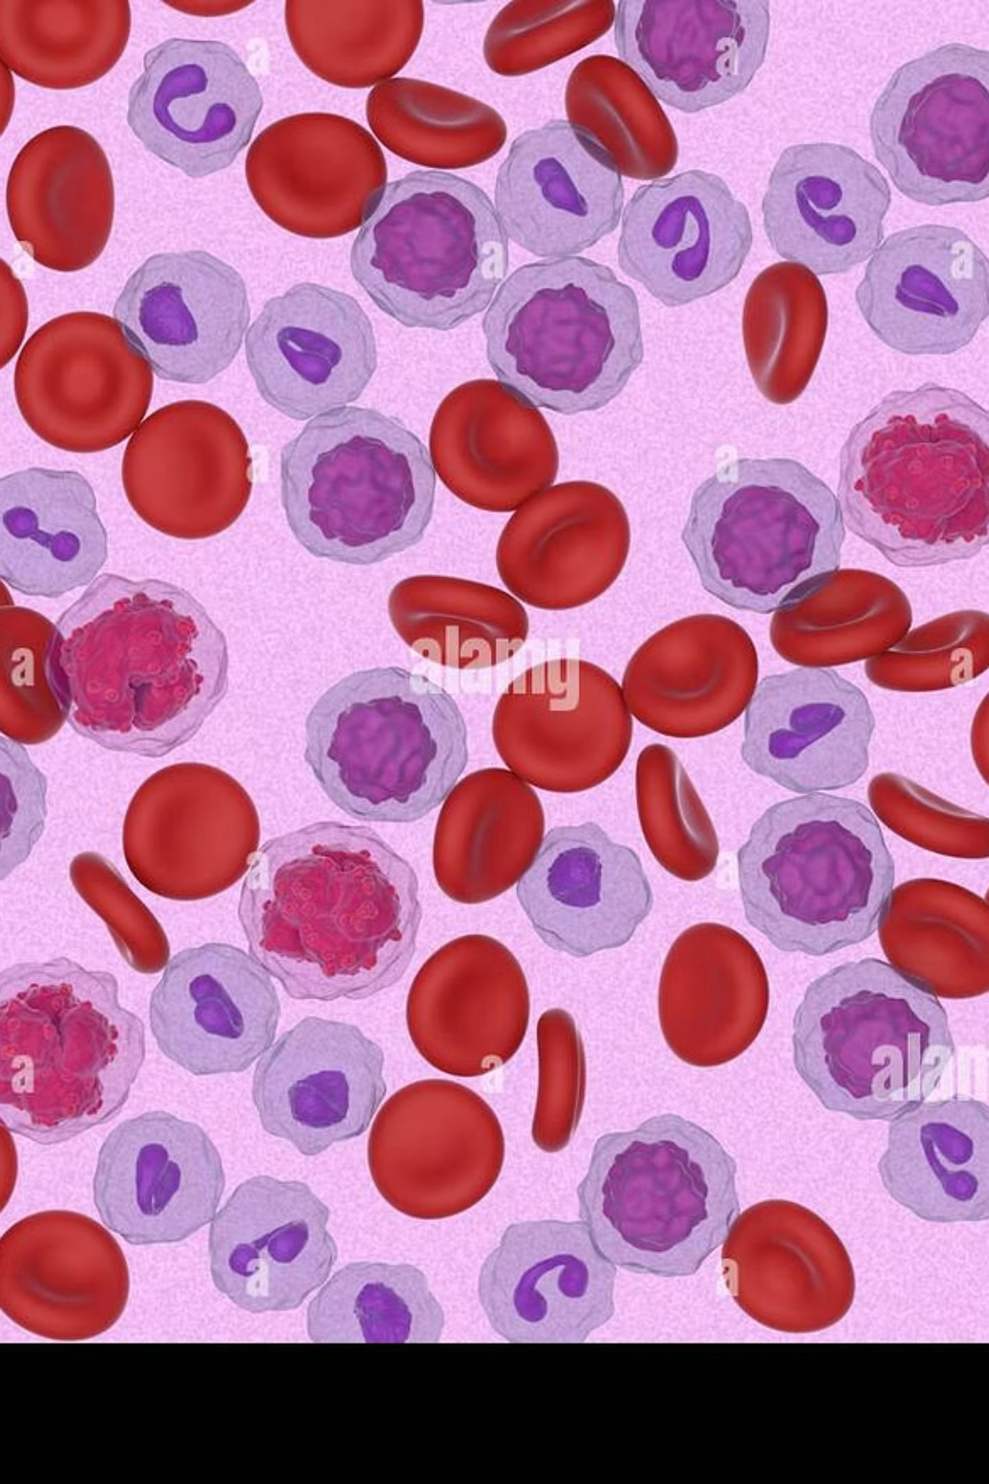
Leukemia Blood Cancer Detection
Using Machine Learning and Deep Learning Models
A final year design project for thesis defense and supervisor evaluation.

Slide 2
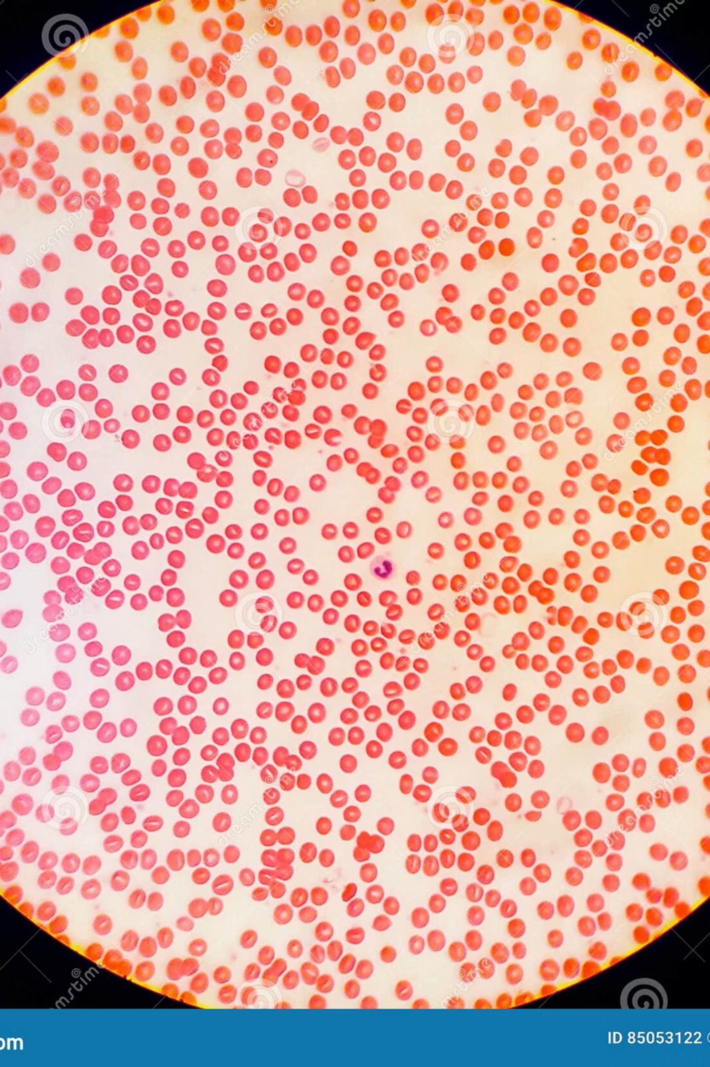
Introduction
Leukemia, a cancer of blood-forming tissues, impacts blood and bone marrow, necessitating early and accurate detection for effective treatment.
Leukemia Overview
Cancer affecting blood and bone marrow.
Early Detection
Crucial for improving patient outcomes.
AI in Diagnosis
Machine learning and deep learning offer advanced diagnostic capabilities.

Slide 3

Background: Traditional Diagnosis
Microscopic Examination
Limitations
Conventional leukemia diagnosis relies on manual microscopic analysis of blood samples.
Time-consuming process
Dependency on expert hematologists
This method is labor-intensive and requires specialized expertise.
Susceptible to human error and subjectivity

Slide 4

Problem Statement
1
Manual Detection Challenges
Slow, subjective, and resource-intensive diagnostic process.
2
Early-Stage Identification
Difficult to detect leukemia in its nascent stages using current methods.
3
Lack of Automated Tools
Absence of efficient, consistent, and automated classification tools.

Slide 5


Motivation: Why This Research Matters
Global Impact
Improved Survival
AI Assistance
Addressing the severity and widespread impact of leukemia.
Early detection significantly enhances patient survival rates.
AI-based models can empower hematologists with better diagnostic support.
Reduced Delays
Automation minimizes diagnostic delays and alleviates workload.

Slide 6

Design Guidelines & Standards
Visual Aesthetics
Presentation Style
White background
Clean layouts with clear headings
Medical / AI research theme
No decorative icons or excessive visuals
Minimal text per slide
Aligned with IEEE academic standards

